Slide 1
Scope and Direction :
These terms describe how a table calculation is computed relative to the table.
When a table calculation is relative to the layout of the table, rearranging the fields in the view will not change the scope and direction.
Scope: The scope defines the boundaries within which a given table calculation can reference other values.
Direction: it defines how the table calculation moves within the scope.
To define the scope and direction for a table calculation, use the drop-down menu for the field in the view and select “ Compute Using”.

Slide 2
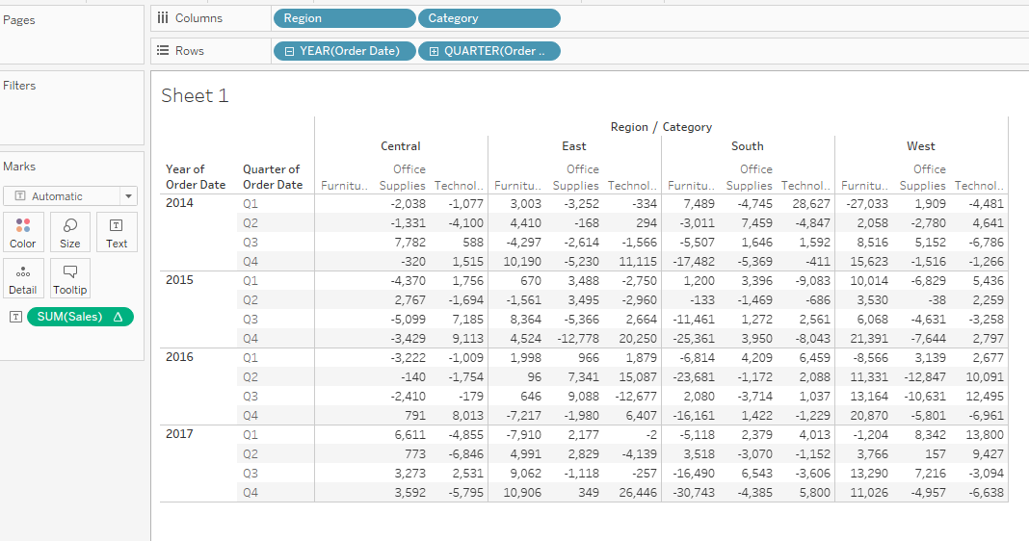
Options for Scope and direction relative to the table:
Scope options: Table, Panes, and cells.
Direction options: Down, Across, down then across, and across then down
In order to understand these options, consider the following example:

Slide 3
Working with scope and direction:
To understand it, consider an example.
Create a new calculated field. Named “ index” with the code index()
Index( ) is a table calculation function that starts with the value 1 and increments by one as it moves along a given direction and within the given scope.
Create table by placing Year(Order Date) and Quarter(Order Date)on Rows and Region and category on Columns.
Now calculated field index is placed in the Text shelf.
Now apply filter for region take only East and West
Now click on Index field in the marks shelf and choose Compute Using
Table (Across ): By default, tableau uses table(Across).

Slide 4
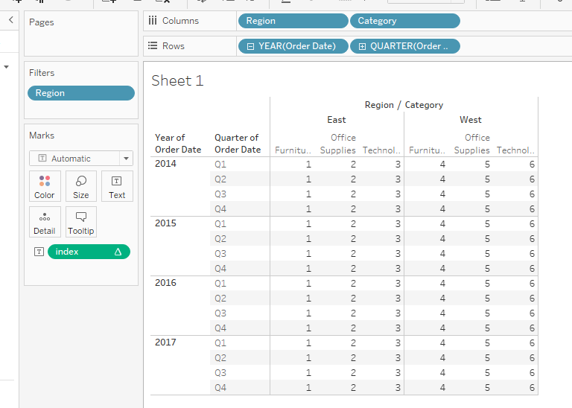
Following example shows how index increments across the entire table

Slide 5
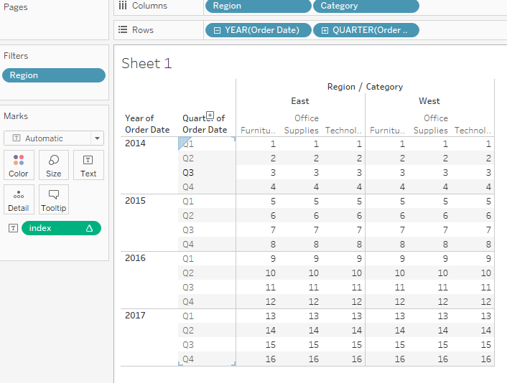
Table (Down):when using table(down), index increments down the entire table as shown:

Slide 6
Table(across then down) : this increment the index across the table, then steps down and continuous to increment across and repeats for the entire table.
Pane(across): This defines the boundary for index and causes index to increment across until it reaches the pane boundary., at which the indexing restart.
Pane(down) :this defines a boundary for index and causes index to increment down until it reaches the pane boundary, at which point the indexing restarts.
Pane(across then down):this allows index to increment across the pane and continue by stepping down.

